Slide 1


Deep learning for NLP (BERT)
William Trimble
Spring 2022

Slide 2


Slide 3
Semisupervised learning
Labeled data is expensive to purchase, commission, curate, etc.
Unlabeled data is not free, but is much cheaper.
Almost every data engineer wonders if the cheap data can be used (in large quantity) to improve the performance of the algorithms that depend on expensive data.
Surely there’s something in there.. correlations to be exploited…

Slide 4
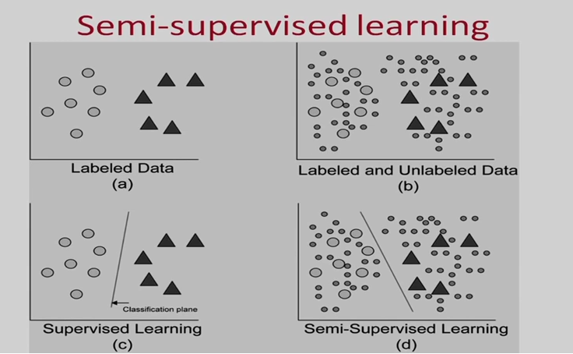
Semisupervised learning

Slide 5
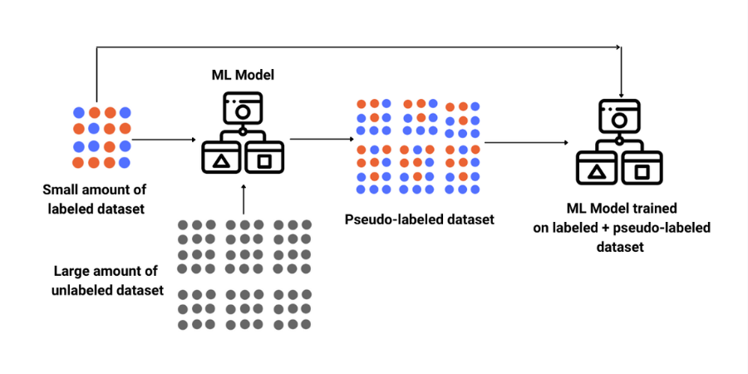

Slide 6
Word embeddings
word2vec and gloVe, elmo are embeddings; pre-trained (linear) mappings from linguistic tokens (100k+ distinct tokens) to a medium-dimensional (few hundreds of dimensions) vector space.
One-hot encodings are used to train this dimension reduction machine, then the output of the dimension reduction (“the embedding”) can be used as the input for other tasks.
continuous bag-of-words (CBOW) or continuous skip-gram are two representations used for encoding; one trains on the (unordered) set of words within k words (word salad?) and one trains on (all) pairs of nearby words in order.
CBOW is cheaper to train, skip-gram tends to work better.

Slide 7
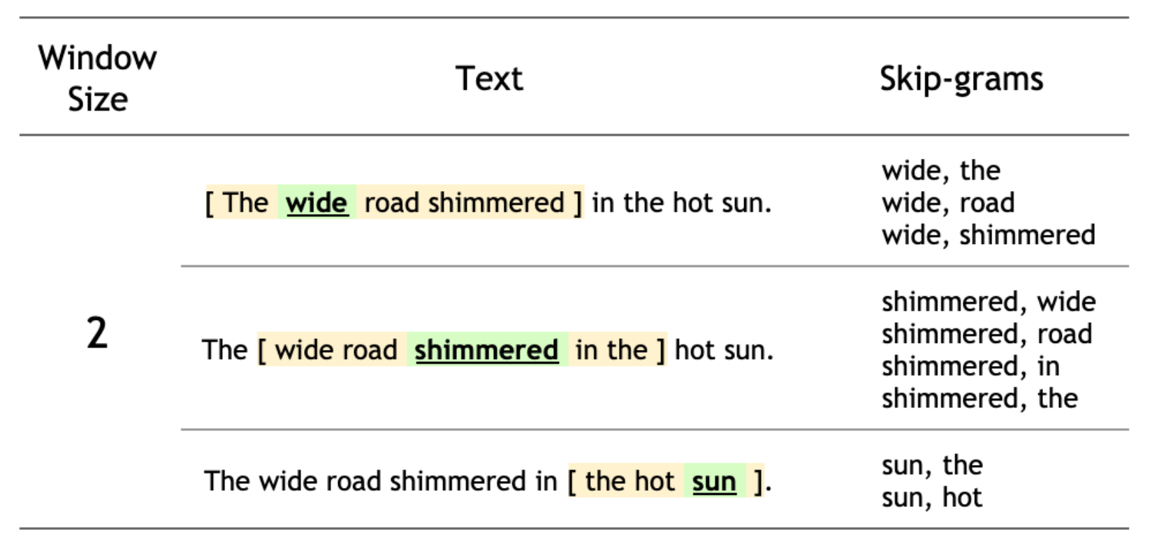
skip-gram construction

Slide 8
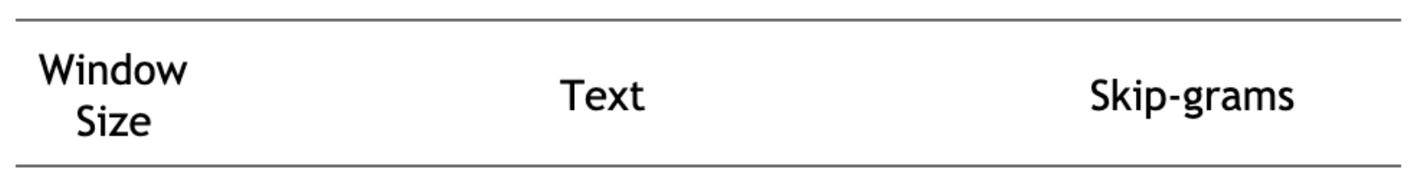
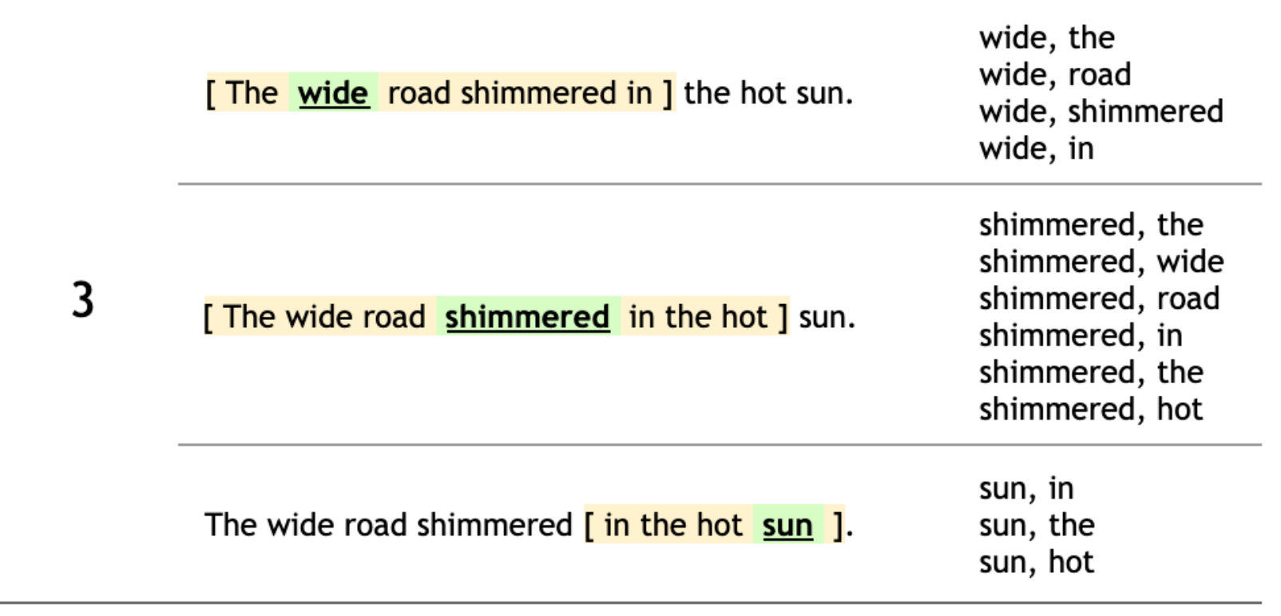

Slide 9
word2vec (Google, 2013) Efficient Estimation of Word Representations in Vector Space arXiv:1301.3781
Semi-supervised Sequence Learning Dai & Le (google) arXiv:1511.01432

Slide 10
Masking the training data, asking model to predict omitted words
I’m not XXXX why there’s an empty Word document on my laptop called dreams
I’m not sure why there’s XXXX empty Word document on my laptop called dreams.
I’m not sure why there’s an empty Word XXXX on my laptop called dreams.
I’m not sure why there’s an empty Word document on my XXXX called dreams.
I’m not sure why there’s an empty Word document on my laptop called XXXX.
Cheap to generate; expense is in the training; should help generalize

Slide 11
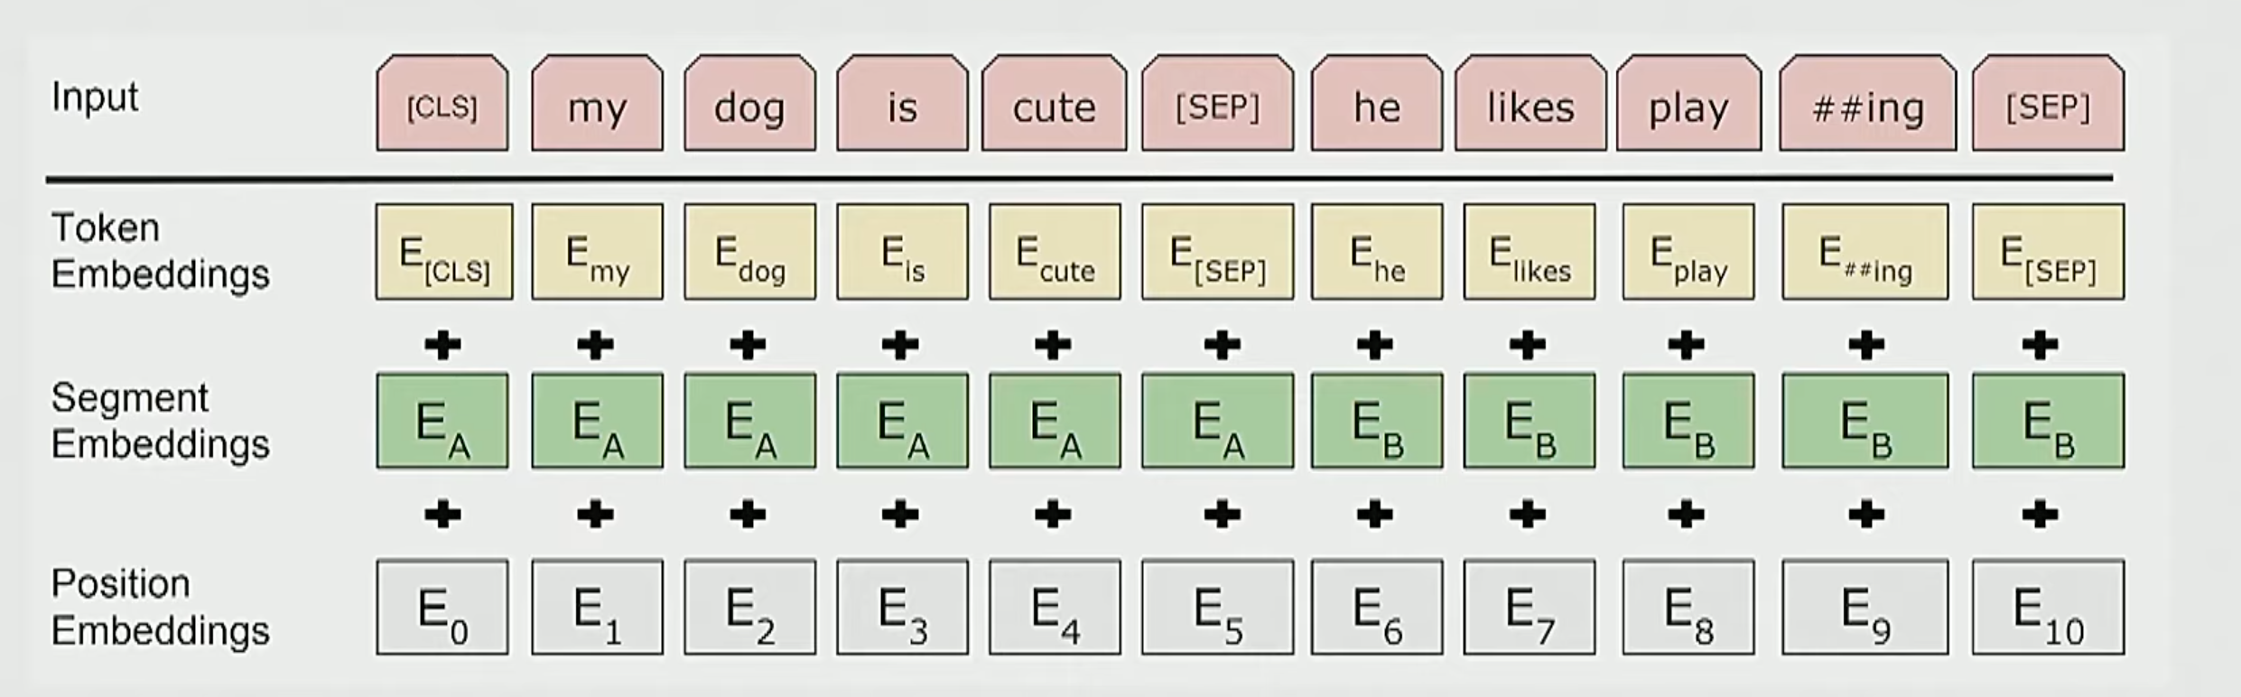

Slide 12
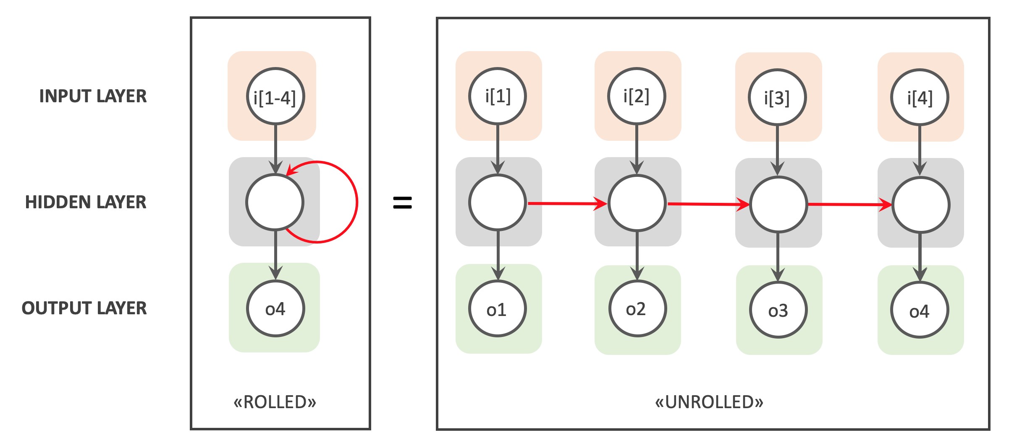
Neural networks for one-dimensional sequences
When building a probability model, you can see the past but not the future. But for embeddings, cheating by looking into the future might help.
Training models on billions of word corpora is slow, costly; can’t do it thousands of times.
Recurrent Neural network: NN design for sequential data;
nodes have input & output layers
that are shared across sequence
inputs but also have feed-forward

Slide 13
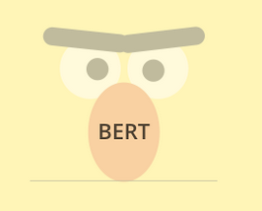
BERT
Trained on Wikipedia (6.5 B words) + BookCorpus (800M words)
Trained in batches of 100k words (100 words * 1000 sequences)
BERT-base: 12-layer, 768 hidden
BERT-large: 24-layer, 1025 hidden
1M training steps, 40 epochs
Trained on 64G-ram google cloud TPU for 4 days (maybe $500 compute cost) https://cloud.google.com/tpu/pricing
2019: RoBERTa: BERT was undertrained, give it another few weeks and accuracy on various tasks gets much better.

Slide 14
BERT
The depth of the model (12- and 24- layers) helps
300M parameters
Trained on up-to-256-word sequences at a time.
Training on both forward- and backward sequences helps.
Evaluated on a zoo of standardized Natural Language Processing tasks like identifying which sentence does not make sense, question answering, sentence completion, identification of related sequential sentences.

Slide 15
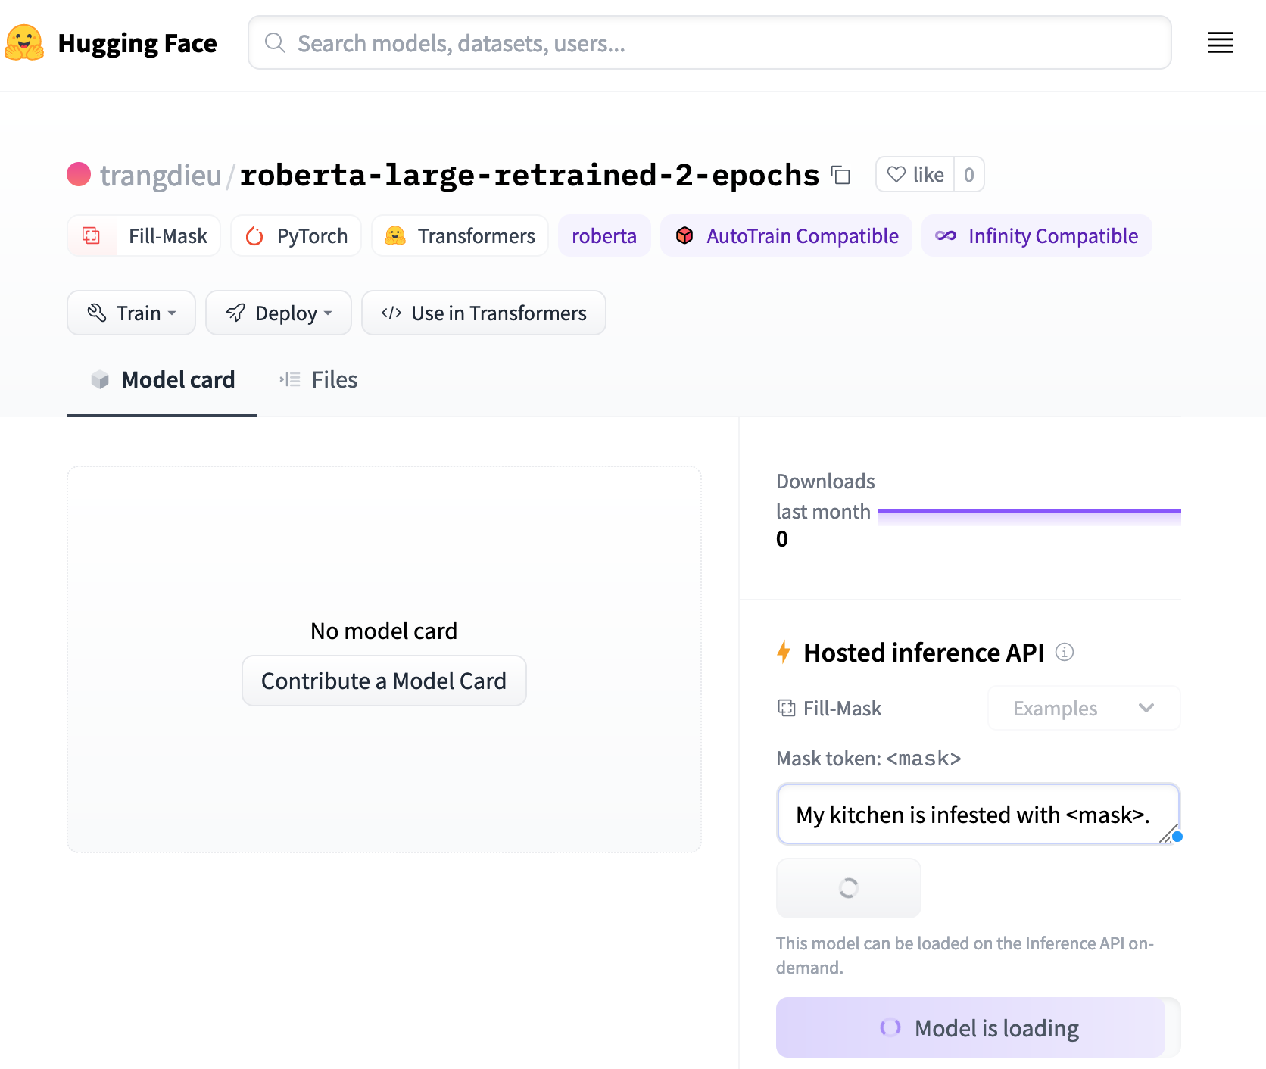
Completion API demo
https://huggingface.co/trangdieu/roberta-large-retrained-2-epochs

Slide 16
“Transfer learning”
Since data became cheap, training models on the data has become compute-limited.
Is there a way to leverage training that has already been done to make new models (for new tasks, or new seasonings / training schedules) to shorten the training time / improve the performance of new models?
Can freeze old model or can retrain old model starting from weights already learned.
Stand on the shoulders of giants at Facebook, Google, Amazon, and Microsoft? Yes!
Build ”Thin” models on top of pretrained

Slide 17
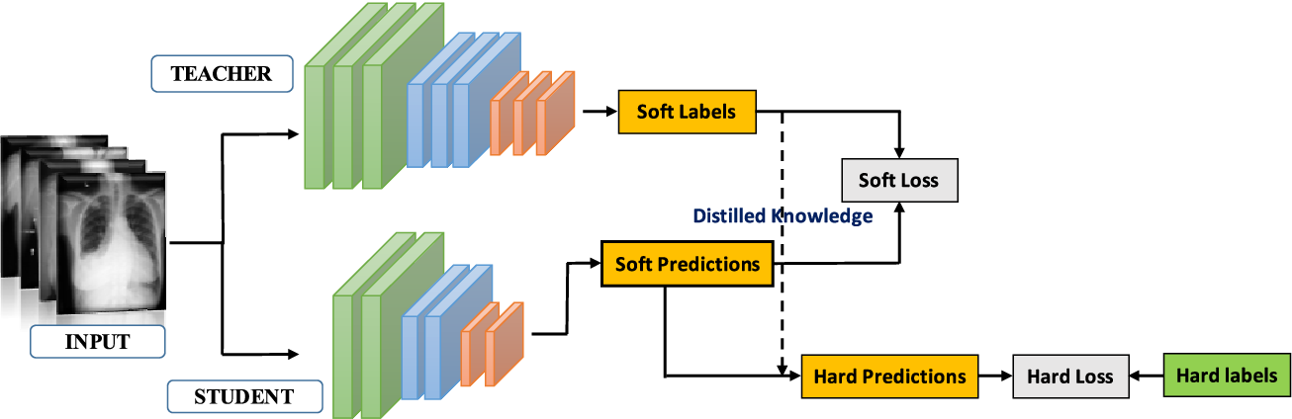
Distillation
Use a model that was expensive to train (like GPT3) to train a much smaller model for a sub-problem
Essentially finding a subset of the big model that is relevant to the real task

Slide 18
NLP big-model takeaways
Pre-trained bidirectional models work really well.
They are expensive to train.
To make them better, need more data or more expensive models.
Distillation also works really well.
If you can turn your data into tokens (bioinformatics) or images you can use off-the-shelf ANNs.
Christopher Manning, Stanfordt

Slide 19
Demo: word2vec embeddings for spam

